Slide 1
Data Visualization and Dashboards with Excel and Cognos
PROFESSIONAL CERTIFICATE IBM Data Analyst

Slide 2
Agenda
Different types of charts
Excel basic charts
Pivot chart visualization
Notes:
Our agenda today is: In this course we will learn how to tell a story with your data
Remember “a picture is worth a thousand words”
Tools we will use in this course: various visualization techniques using Excel and Cognos

Slide 3

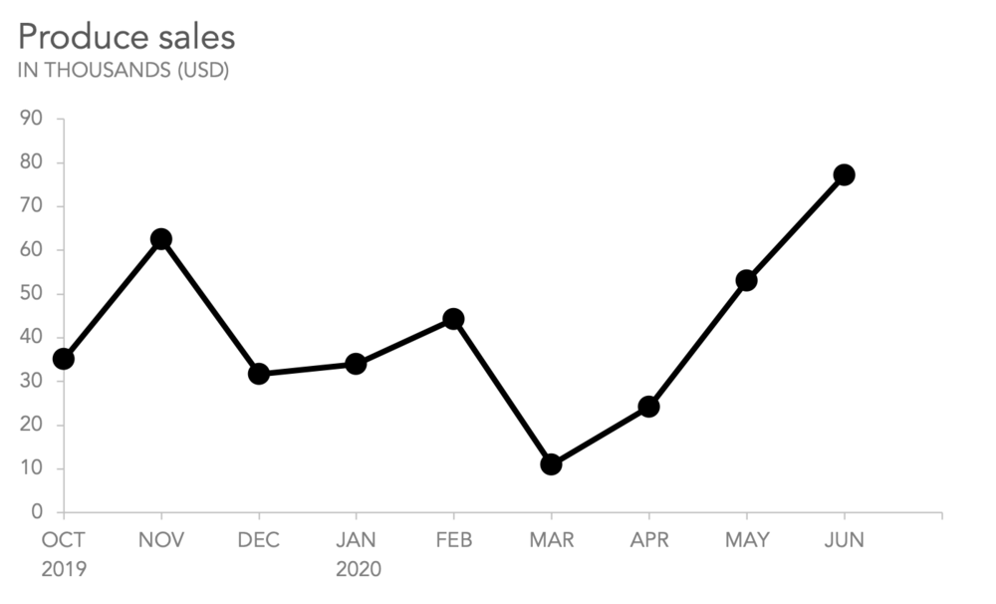
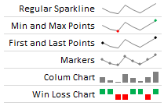
Different Types of Charts
Line charts “continuous data”
Spark lines “Trends”
www.chandoo.org
Notes:
Line charts: They are able to display trends and show how a data value is changing in relation to a continuous variable.
Example: How the sales of the hand sanitizers has changed over a specific time “Since COVID started”
The horizontal axis typically represents time or a similar category, and the vertical axis typically represents numerical values.

Slide 4
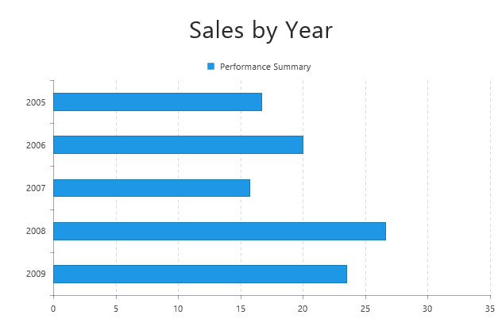
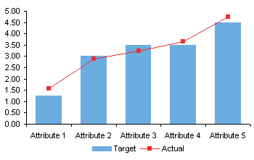
Different Types of Charts
Bar charts “Horizontal”
Column charts
docs.telerik.com
peltiertech.com
Notes:
Bar charts classified into two types H,C : This type of chart is the most common as they are easy to create and are great for comparing related data .
The categories are usually arranged on the vertical axis, and the values are on the horizontal axis.
Column charts comparing non continues data over time, the categories are typically arranged on the horizontal axis, and the values are displayed on the vertical axis.
We can also use bar and line charts together to visualize more complex data
Ask participants which one is better suited for showing negative and positive values? Answer is column chart

Slide 5
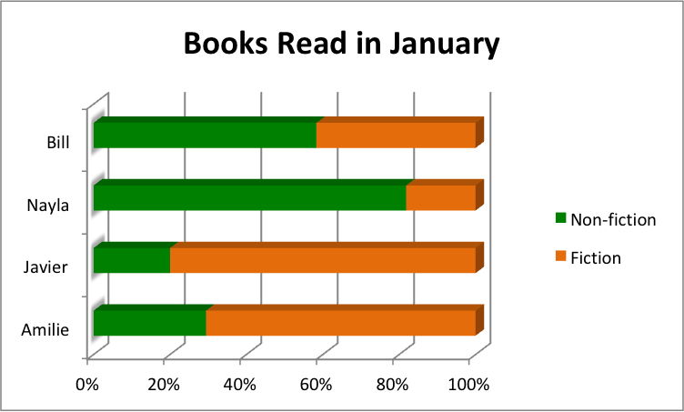
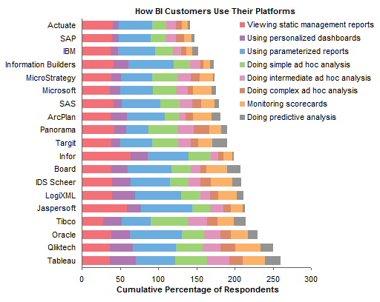
Different Types of Charts
Stacked bars
What do you think about the other chart?
smartsheet.com
Peltier Tech Blog

Slide 6
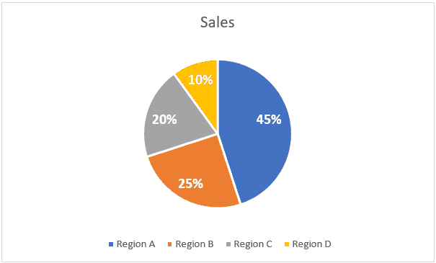
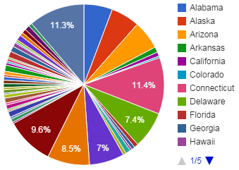
Different Types of Charts
Pie charts “proportional data”
What do you think about the other chart?
trumpexcel.com
commadot.com
Notes:
Pie charts: can be used to visualize proportional data while the sum of all portions or categories =100%.
Like NE,NW,SE,SW
or Survey response “ Strongly agree, agree, disagree” so on…..
your data contains no more than maybe a dozen categories, otherwise the pie chart can start to look too busy and become difficult to read.

Slide 7
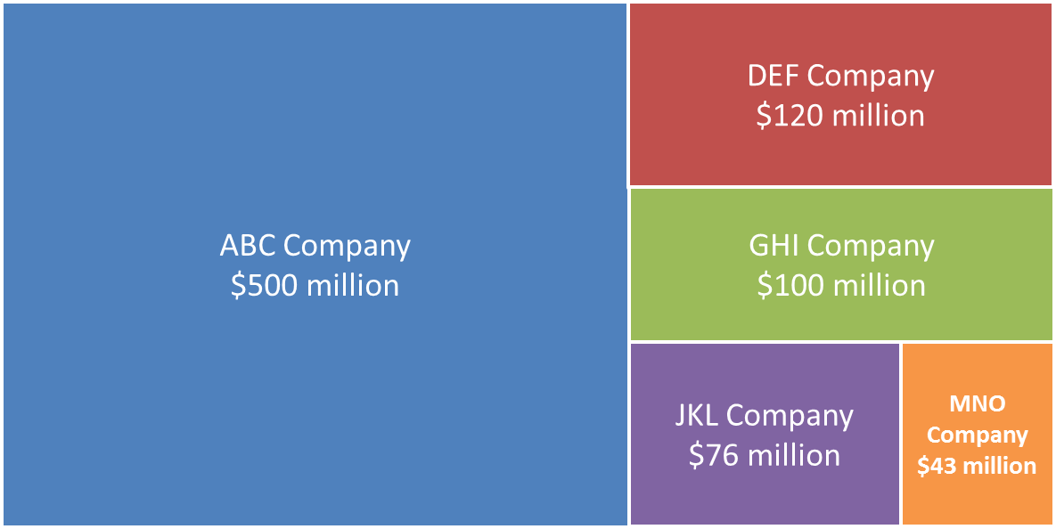
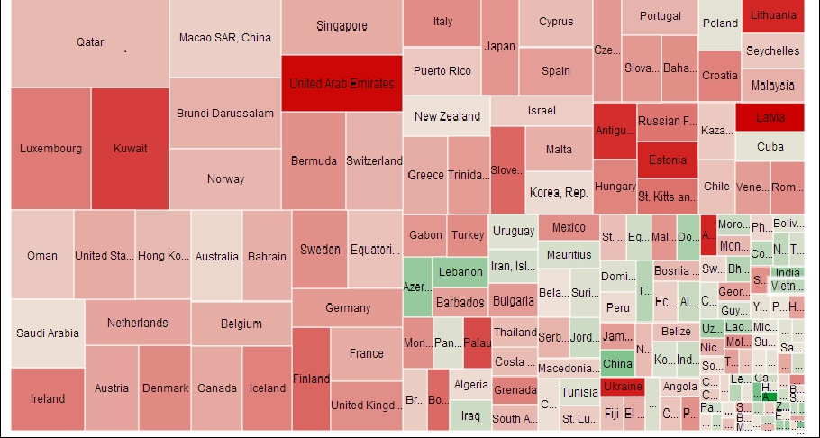
Different Types of Charts
Treemaps “complex hierarchies”
What do you think about the other chart?
thinkoutsidetheslide.
subscription.packtpub.com
Notes:
Treemaps The size of the rectangle represents the population/COVID cases, and the color represents the provinces.
example: visualizing all provinces in Canada according to the positive COVID cases over the last year, or state-wide employment rate

Slide 8
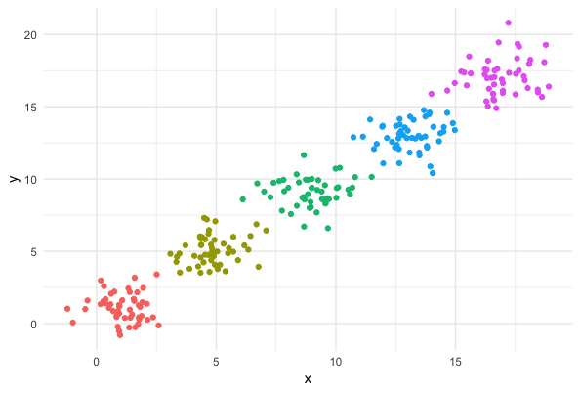
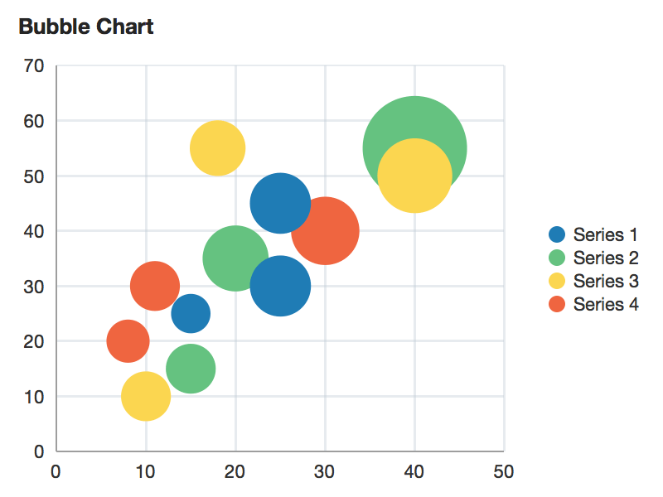
Different Types of Charts
Scatter chart “clusters, patterns, correlations”
Bubble charts “comparing in terms of relative significance”
helicalinsight.com
Notes:
Scatter chart:
Bubble charts: variant of scatter charts. Example significant budget for a company for the departments “IT, HR, finance, legal,….” note that the bubbles would be relatively significant
The circle colors represent the categories of data and the circle sizes are indicative of the volume of data.

Slide 9
Breakout Room Activity
Download the Life is a Rollercoaster dataset from Schoology.
Explore the data with your team
Which data is important to visualize?
Which charts are you going to use?
What kind of charts you can’t use for this dataset?
Notes:
They can’t use line chart as there is no contentious data, no scatter chart …….

Slide 10
Excel Basic Charts
01
02
03
04
Select the data that you want to visualize
Insert the proper a chart to present you data in Excel
Change the title and the chart style accordingly
Change the color palette to fit your needs
Notes:
Remember colors should be representative. Like red for cities with large numbers of COVID, green for areas free of COVID
Students grads (green=pass, red=fail, yellow=critical) and so on.

Slide 11
Breakout Room Activity
Download the Basic data visualization activity from Schoology, follow the instructions, and be prepared to share your findings in the main room.

Slide 12
Pivot chart visualization
Advantages
Filter the data in the pivot chart itself
Dynamic charts
Changes in the data table automatically reflected into the Pivot chart
Notes:
When we filter the data from the chart, the chart will change to present the new filtered data, and the changes will be immediately reflected to the chart accordingly
Also changing the data in the original table, we automatically be reflected into the pivot chart

Slide 13
Any questions

